Slide 1
Project 4
Post Processing in
Optical Character Recognition
Group 6

Slide 2
Introduction
This Project is to perform error detection and correction in post-processing stage of Optical Character Recognition (OCR)

Slide 3
Error Detection:
D-2 (n-grams)
Error Correction:
C-4 (Probability Scoring)

Slide 4
Error Detection: n-gram
N-gram:
A contiguous sequence of n items from a given sample of text
Example:
Word: “set”
Binary digram (n=2) pairs: (s,e), (s,t), (e,s), (e,t), (t,s), (t,e)

Slide 5
Error Detection: n-gram
Positional Binary Matrix:
A 26*26 binary matrix for every possible letter pair (i,j)
D(i,j) is the element of ith row, jth column
D(i,j) = 1 if pair (i,j) appears, otherwise 0

Slide 6
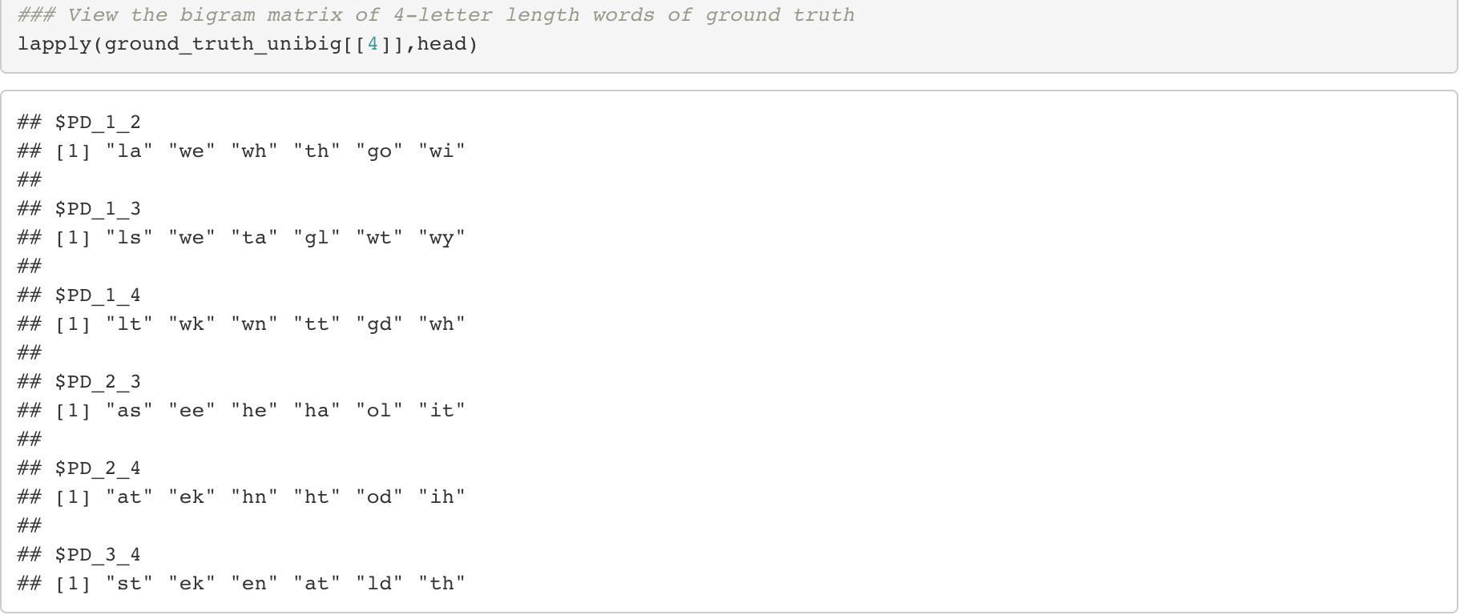
Error Detection – Example of Bigram Matrix

Slide 7
Error Detection: n-gram
Steps:
Construct positional binary matrices using Ground Truth (correct text)
Text cleaning: remove numbers, punctuations and symbols
Split text by words and find all bigrams of each words
Create positional binary matrix for each world length
Construct word list using Tesseract (test text)
Error detection
Compare each word in word list with corresponding positional binary matrix
If all binary pairs of a word in word list are found in the positional binary matrix then the word is correct, otherwise is classified as error

Slide 8
Error Detection: n-gram
Limit of the method: Some errors are undetectable.
Example 1: error = sut, could be identified as correct when sat, cut, sun all appear in Ground Truth
Example 2: number errors are not detected (error = 13, correct = b)

Slide 9
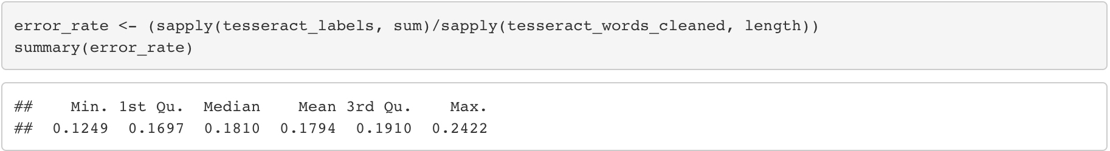
Error Detection – Preliminary Analysis

Slide 10
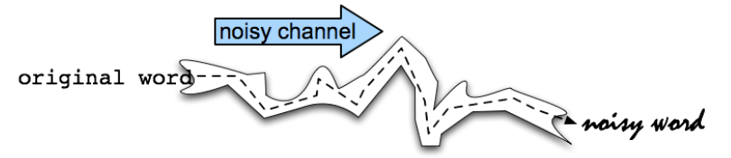
Error Correction: Probability Scoring
Assumption: Typist knows what he/she wants to type, yet typos happen
Idea: Use Bayesian argument by choosing a high probability score among all possible candidates (proposed corrections)

Slide 11
Error Correction: Probability Scoring
c=argmax P(c|t)
=argmax P(t|c)P(c)/P(t)
=argmax P(t|c)P(c)
Where
c = correct word
t = typo

Slide 12
Error Correction: Probability Scoring
3 methods to estimate prior probability P(c):
Maximum Likelihood Estimate (MLE)
Expected Likelihood Estimate (ELE)
Good Turing (GT)
P(c):
MLE: r/N
ELE: (freq(c) + 0.5)/(N + V/2)
GT: (r + 1)N(r+1)/N(r).
r: observed frequency
N: corpus length
V: all vocabulary size

Slide 13
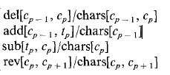
Error Correction: Probability Scoring
4 methods of correction for P(t|c):
Delete
Insert
Replace
Reverse

Slide 14
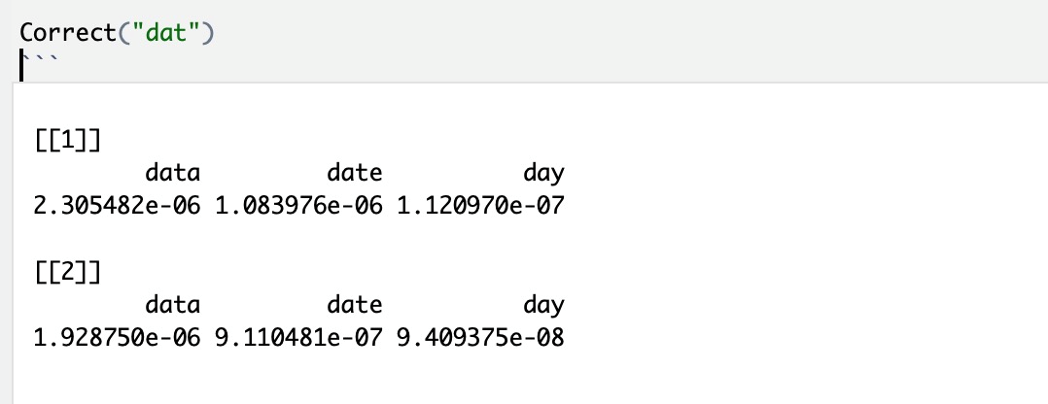
Error Correction: Probability Scoring

Slide 15
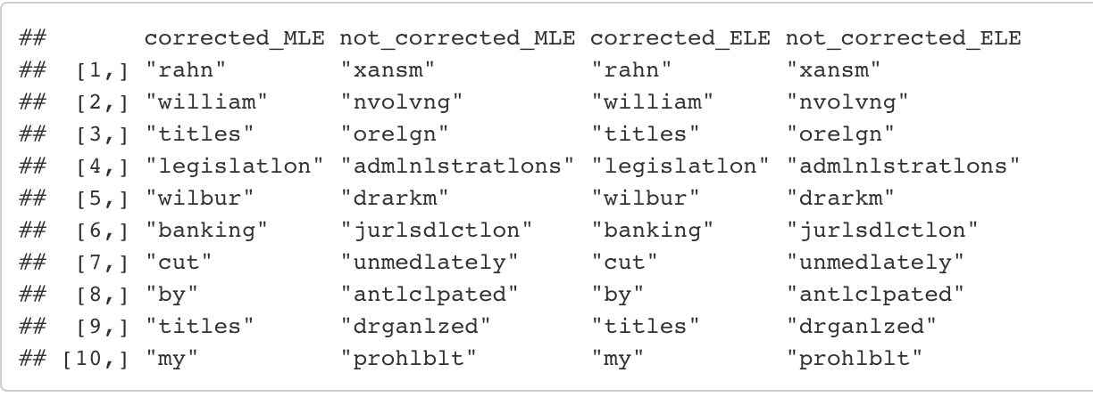
Error Correction: Final results
Without Context

Slide 16
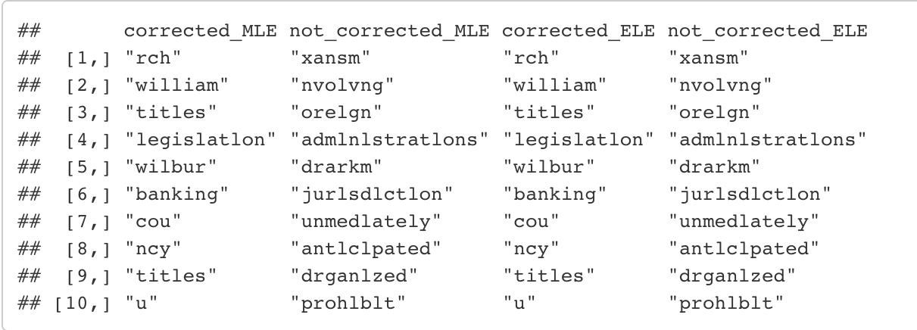
Error Correction: Final results
With Context

Slide 17
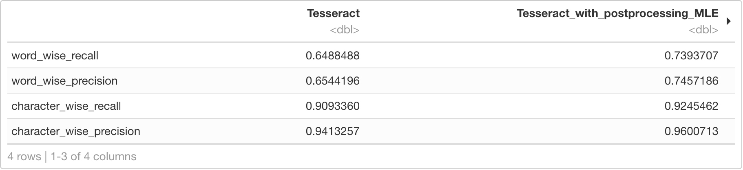
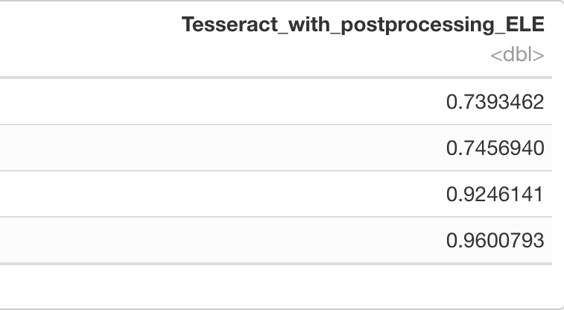
Performance - without context

Slide 18
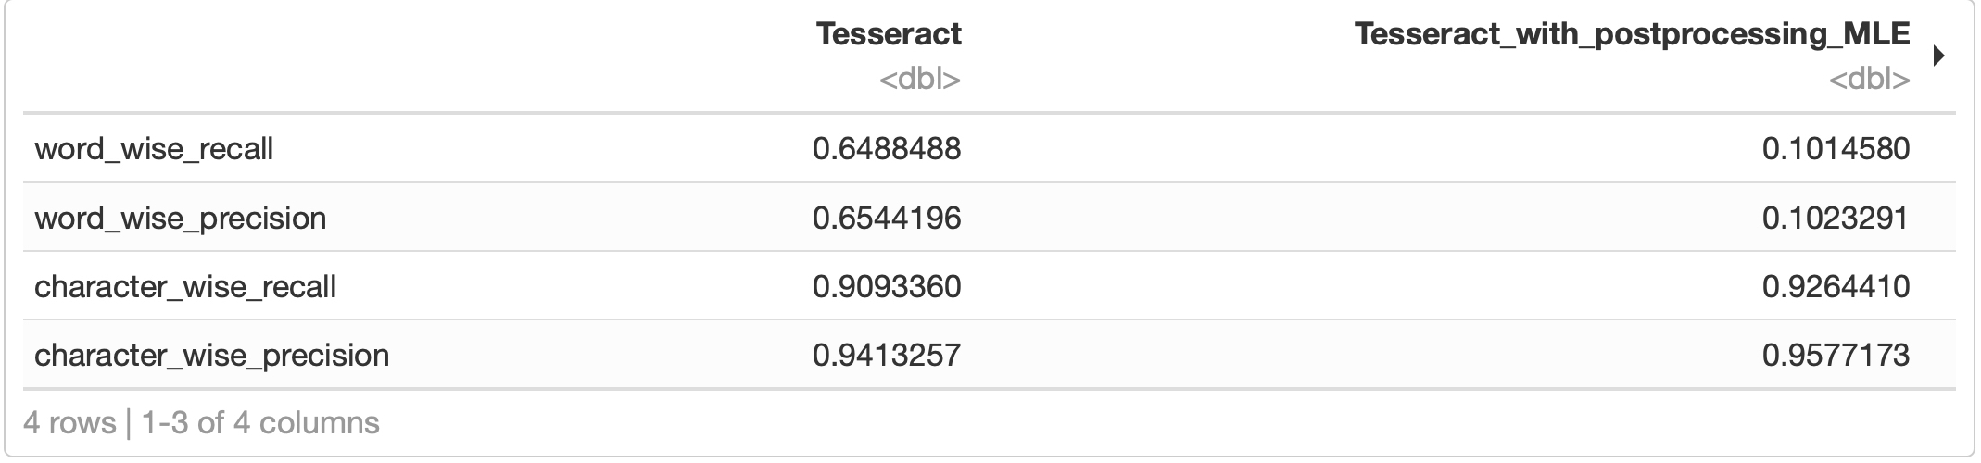
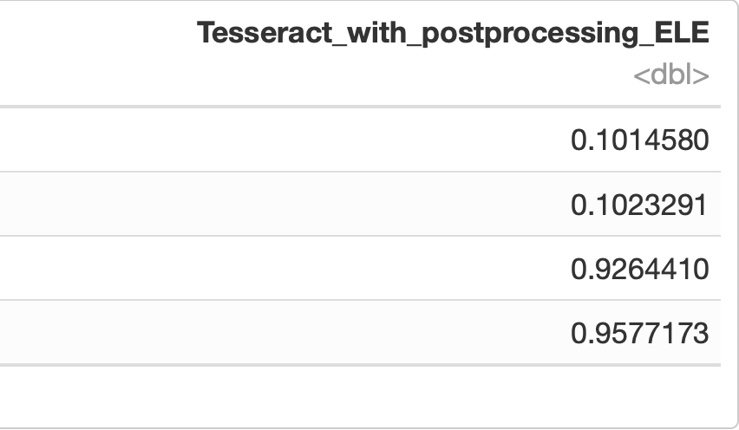
Performance: - with context
As we can notice, the performance of MLE and ELE with context are very bad since MLE and ELE doesn’t estimate P(l|c) and P(r|c) well. This conclusion agrees with the results in the paper C4.

Slide 19
Thank you!
Q&A

